Slide 1
CSCI 2141 Lab 10
November 26, 2018

Slide 2
Agenda
Java Application Example

Slide 3
Lab Preparation
For this lab, we will continue to use same database from last lab.
You can download the salesDB.sql file from Brightspace (Content > Lab 6), copy and paste it into a query tab in MySQL Workbench, and run the entire script to set up the tables.
If you’re on Bluenose, you can run it as is. If you’re on your local server, uncomment lines 3 and 4 to create and use a new database.
This Lab includes a JAVA Project build on Netbeans IDE. If you use any other IDE, use .java files under “Lab10Example1\src\lab10example1” folder.

Slide 4
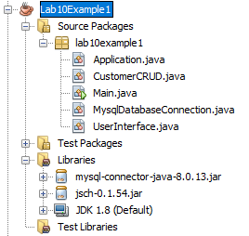
JAVA Example Project
5 Java Files
Application.java
CustomerCRUD.java
Main.java
MysqlDatabaseConnection.java
UserInterface.java
2 Dependency Libraries
MySQL Connector (mysql-connector-java-8.0.13.jar)
Java SSH (jsch-0.1.54.jar)

Slide 5
JAVA Example Project (Cont.)
Project Name : Lab10Example1
Simple Console Based Java application to
View Customer
Update Customer
View Products bought by Customers

Slide 6

JAVA Example Project (Cont.)
File : Main.java
Purpose
Create object of Application Class
Start Application

Slide 7
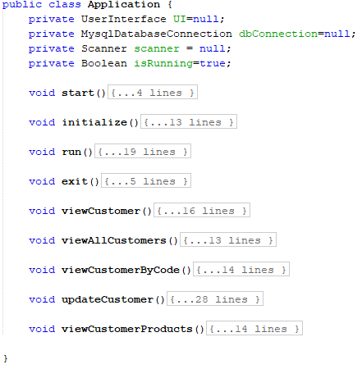
JAVA Example Project (Cont.)
File : Application.java
Purpose
Provide structured flow to application.
Implements business logic for the project.

Slide 8
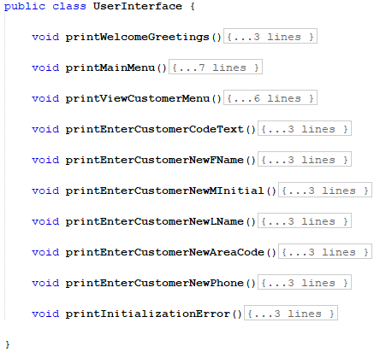
JAVA Example Project (Cont.)
File : UserInterface.java
Purpose
Encapsulate the working of User Interface to a separate module.
All User text messages are defined here.

Slide 9
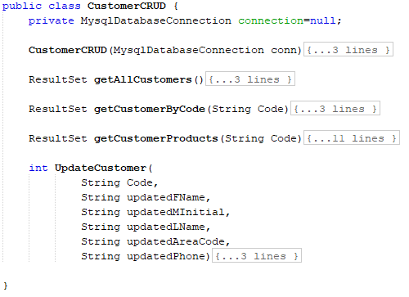
JAVA Example Project (Cont.)
File : CustomerCRUD.java
Purpose
Module dedicated for MYSQL Queries execution.
All Queries related to each operation are defined here.

Slide 10
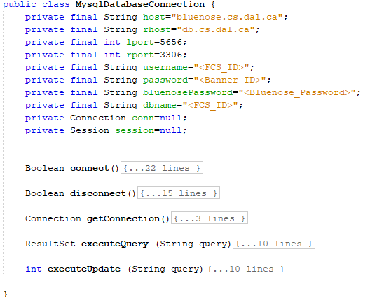
JAVA Example Project (Cont.)
File : MysqlDatabaseConnection.java
Purpose
Logic related to Database connection are defined here.
Configuration related to Database Connection can be changed from this file.
Update Credentials before using this class.

Slide 11
Thank You!

